Slide 1


HOUSING: PRICE PREDICTION

Slide 2

Housing Price Prediction

Slide 3
Problem Statement
Houses are one of the necessary need of each and every person around the globe and therefore housing and real estate market is one of the markets which is one of the major contributors in the world’s economy. It is a very large market and there are various companies working in the domain. Data science comes as a very important tool to solve problems in the domain to help the companies increase their overall revenue, profits, improving their marketing strategies and focusing on changing trends in house sales and purchases. Predictive modelling, Market mix modelling, recommendation systems are some of the machine learning techniques used for achieving the business goals for housing companies. Our problem is related to one such housing company.

Slide 4
Business Goal
Technical Requirements :
Data contains 1460 entries each having 81 variables.
Data contains Null values. We need to treat them using the domain knowledge and our own understanding.
Extensive EDA has to be performed to gain relationships of important variable and price.
Data contains numerical as well as categorical variable. We need to handle them accordingly.
We have to build Machine Learning models, apply regularization and determine the optimal values of Hyper Parameters.
We need to find important features which affect the price positively or negatively.
Two datasets are being provided to you (test.csv, train.csv). We will train on train.csv dataset and predict on test.csv file.
We are required to model the price of houses with the available independent variables. This model will then be used by the management to understand how exactly the prices vary with the variables. They can accordingly manipulate the strategy of the firm and concentrate on areas that will yield high returns. Further, the model will be a good way for the management to understand the pricing dynamics of a new market.

Slide 5
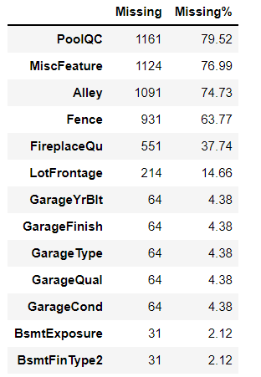
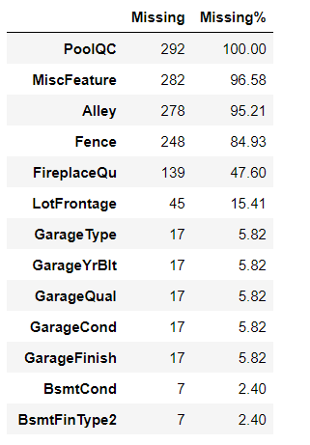
Percentage of Null data Train Dataset
Percentage of Null data Test Dataset

Slide 6
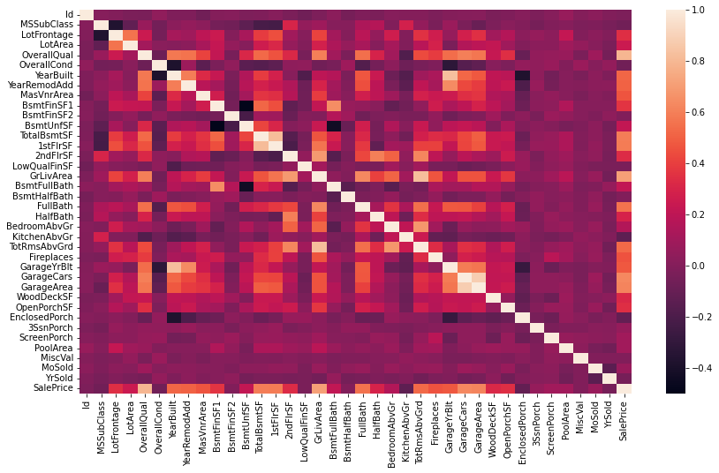
Slide 27
Correlation Of Train Dataset

Slide 7
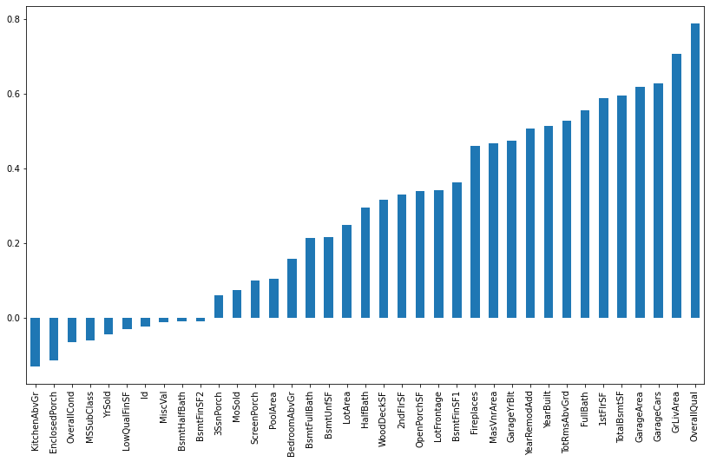
Slide 27
Relationship between Output and Input of train Dataset .

Slide 8
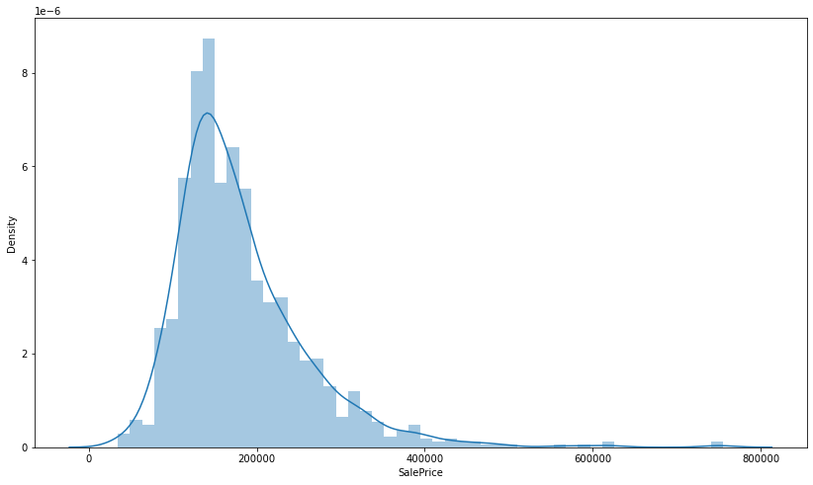
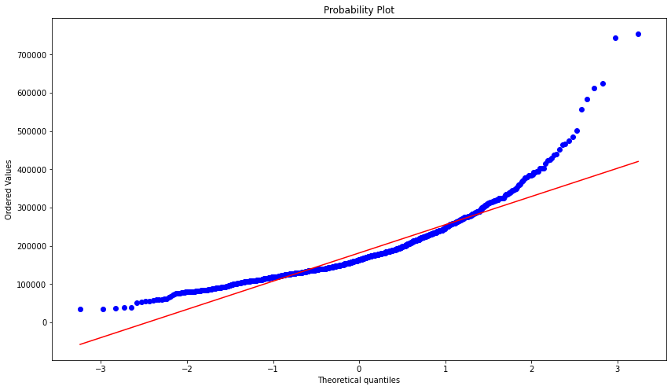
Distribution Plot and Probability Plot of Train Dataset
Distribution Plot of Sale Price
Probability Plot of Sale Price

Slide 9
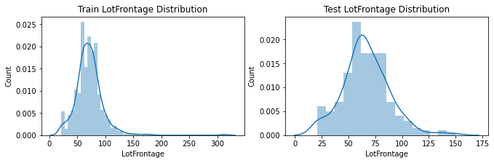
Feature engineering in Dataset
From above description we can see that, mean values is 70, and 25% percent value is 59 or less than this, it means 75 percent values are greater than 59. From these 3 facts we can be sure to fill null values with mean values. Lets do this. To avoid any heavy incosistency lets take some intermediate value between 59 and 70(mean of column Lotfrontage), say 65

Slide 10
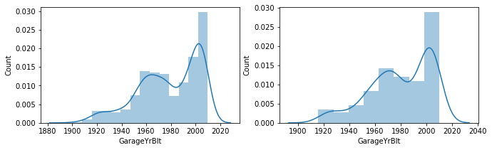
Feature engineering in Dataset
Data is scattered vastly, it is not normally distributed we can't use mean value to fill missing records. We need to look at the data more closely. Also data distribution is not a normal distribution. we can choose the method 'bfill' or 'ffill', but before we do that lets observe sample between different ranges of indexe to find if NaN values have some relation to other columns. For this I will first print records train dataset where GarageYrblt is NaN.

Slide 11
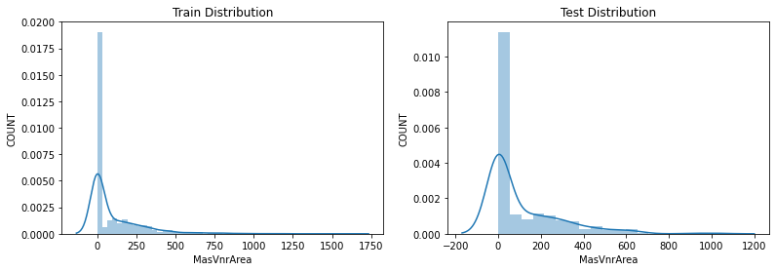
Feature engineering in Dataset
This column has just 8 missed records, and is float type column . Most value is zero, and since this column has just 8 missed record,we will fill all values with 0, As distribution is not like Gaussion distribution, we can't use mean to fill missing values
In similar way, we apply suitable Feature Engineering in Data According to each columns.

Slide 12
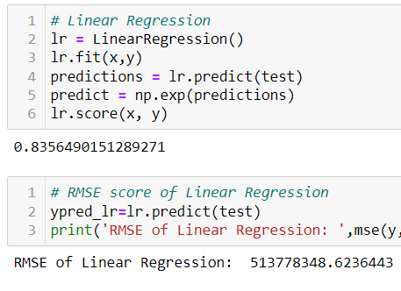
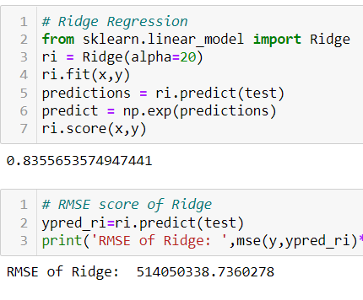
Model Development
Linear Regression
Ridge Regression
Linear Regression score :-
83.56%
RMSE of Linear Regression :-
513778348.6236
Ridge Regression :-
83.55%
RSME of Ridge Regression :-
514050383.7360

Slide 13
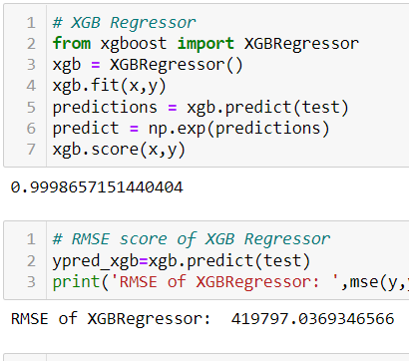
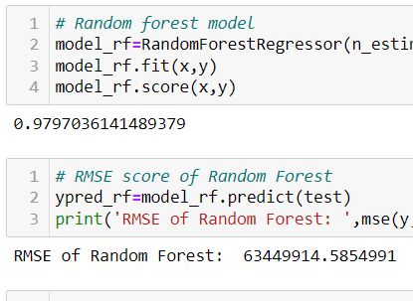
Model Development
XGB Regression
Random Forest
XGB Regression score :-
99.9865%
RMSE of XGB Regression :-
419797.0369
Ridge Regression :-
97.97%
RSME of Ridge Regression :-
63449914.5854

Slide 14
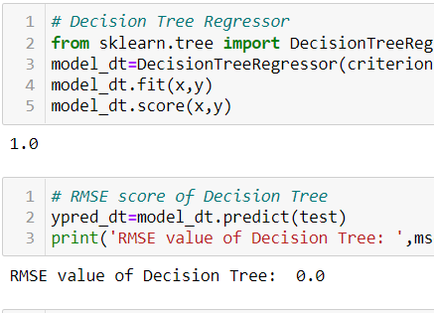
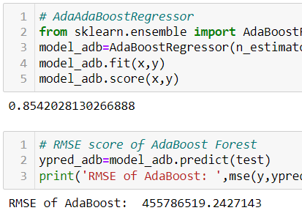
Model Development
Decision Tree Regression
Ada Boost Regression
Linear Regression score :-
100.00%
RMSE of Linear Regression :-
000.00
Ridge Regression :-
85.42%
RSME of Ridge Regression :-
455786519.2427

Slide 15

Conclusion
Through different types of Model Development
we can see that Decision Tree Regression is the best model as it’s Score was 100.00% and RSME score is also 000.00 .

Slide 16
Thank You

